Slide 1
Fashion-MNIST Image Classification using ANN and CNN Architectures
Coursework Assessment – Neural Systems Module
Adulcinio Rosa
P2744127
Tutor: Amudhavel Jayavel

Slide 2
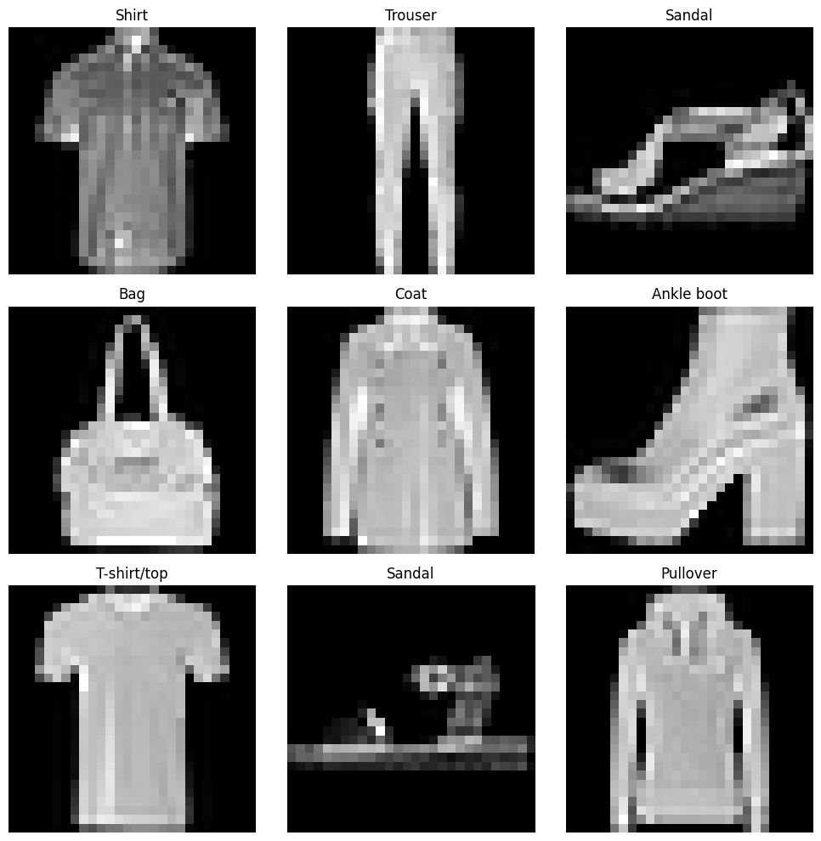
Introduction
Dataset: Fashion-MNIST → 70,000 grayscale images (28×28 pixels)
Classes: 10 clothing categories — e.g., shirts, shoes, trousers, bags, jackets
.Goal: Compare performance
Artificial Neural Network (ANN
VS
Convolutional Neural Network (CNN)
Focus: Evaluate CNN’s ability to capture spatial structure in images
Evaluation Metrics: Accuracy, confusion matrix, classification errors

Slide 3
Objectives
✔Implement Artificial Neural Network (ANN) and Convolutional Neural Network (CNN) using
PyTorch
✔ Preprocess and normalize the Fashion-MNIST dataset to prepare it for model training
✔ Train and evaluate both models using accuracy and confusion matrix metrics
✔Compare performance of ANN and CNN to understand their strengths and weaknesses
✔ Analyze and discuss model behavior, limitations, and possible improvements

Slide 4
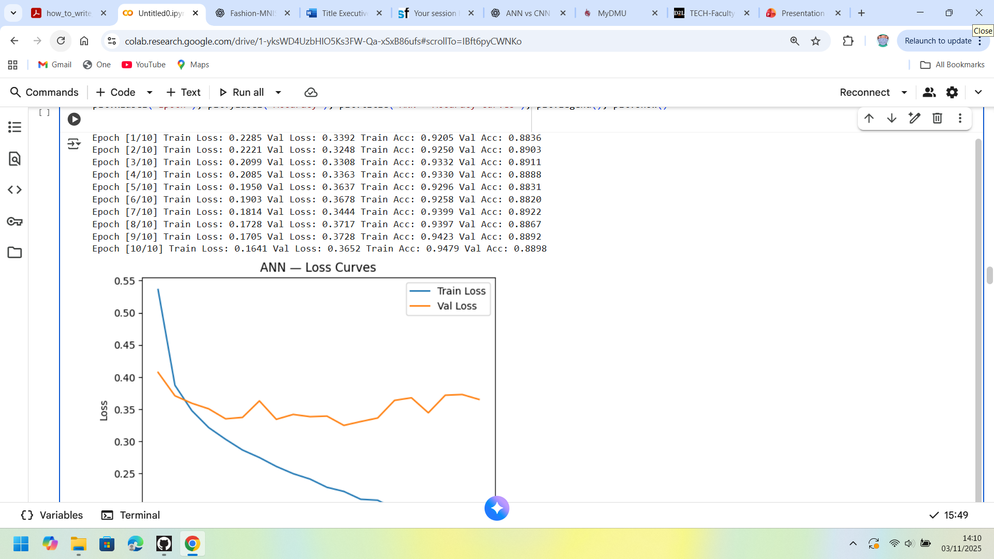
Dataset & Preprocessing
Dataset: Fashion-MNIST → 60,000 train / 10,000 test images
Normalization: Pixel values scaled to (−1 to 1)
Split: Training : Validation = 80 : 20
Augmentation: Random rotation and horizontal flip to increase data variety

Slide 5
Model Architectures
ANN
“Flatten (28×28 → 784)”
“Hidden Layer 1: 128 neurons (ReLU)”
“Hidden Layer 2: 64 neurons (ReLU)”
“Output Layer: 10 classes (Softmax)”
CNN
.Input (28×28) → Conv2D (1→32, 3×3, ReLU) → MaxPool (2×2) →
.Conv2D (32→64, 3×3, ReLU) → MaxPool (2×2) → Flatten (7×7×64) →
. Dense (128, ReLU) → Dropout (0.5) → Output (10 classes)

Slide 6
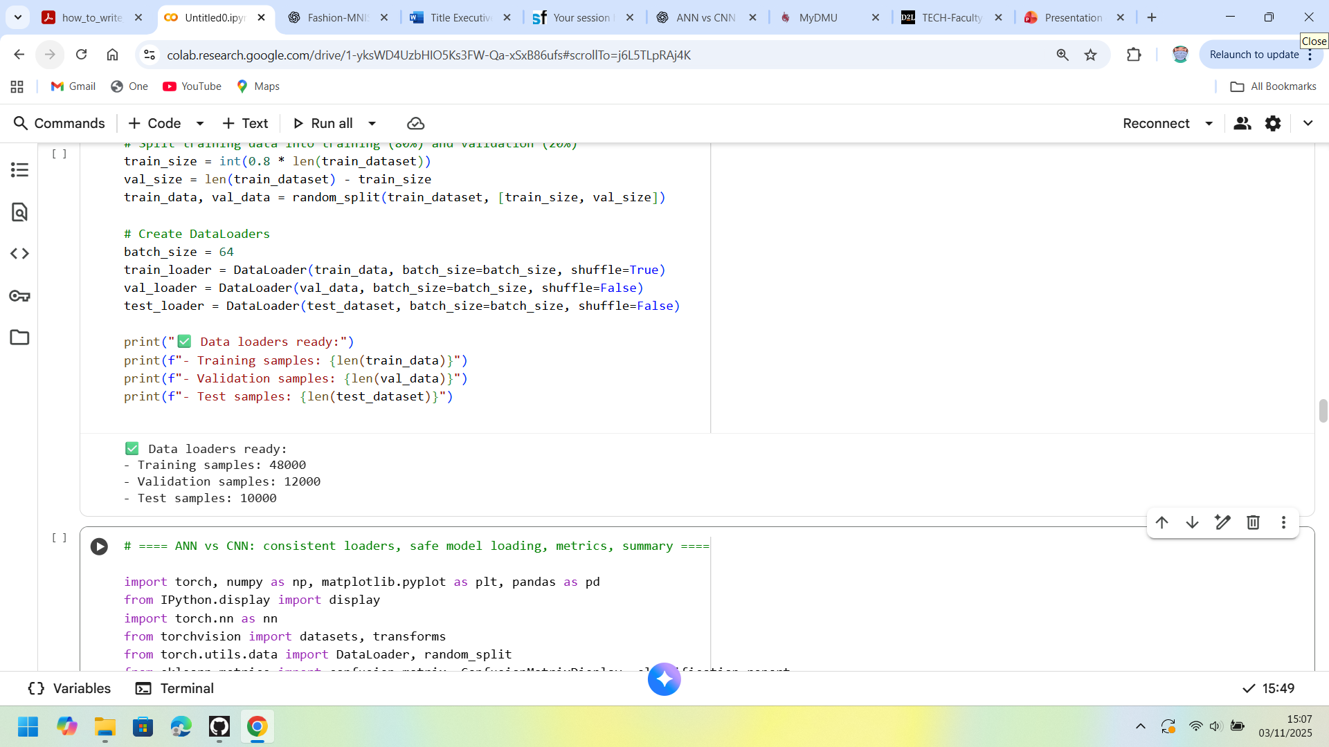
Training Setup (PyTorch)
Optimizer: Adam (lr = 1e-3)
Loss: CrossEntropyLoss
Batch size = 64, Epochs = 10
Dropout and scheduler applied

Slide 7
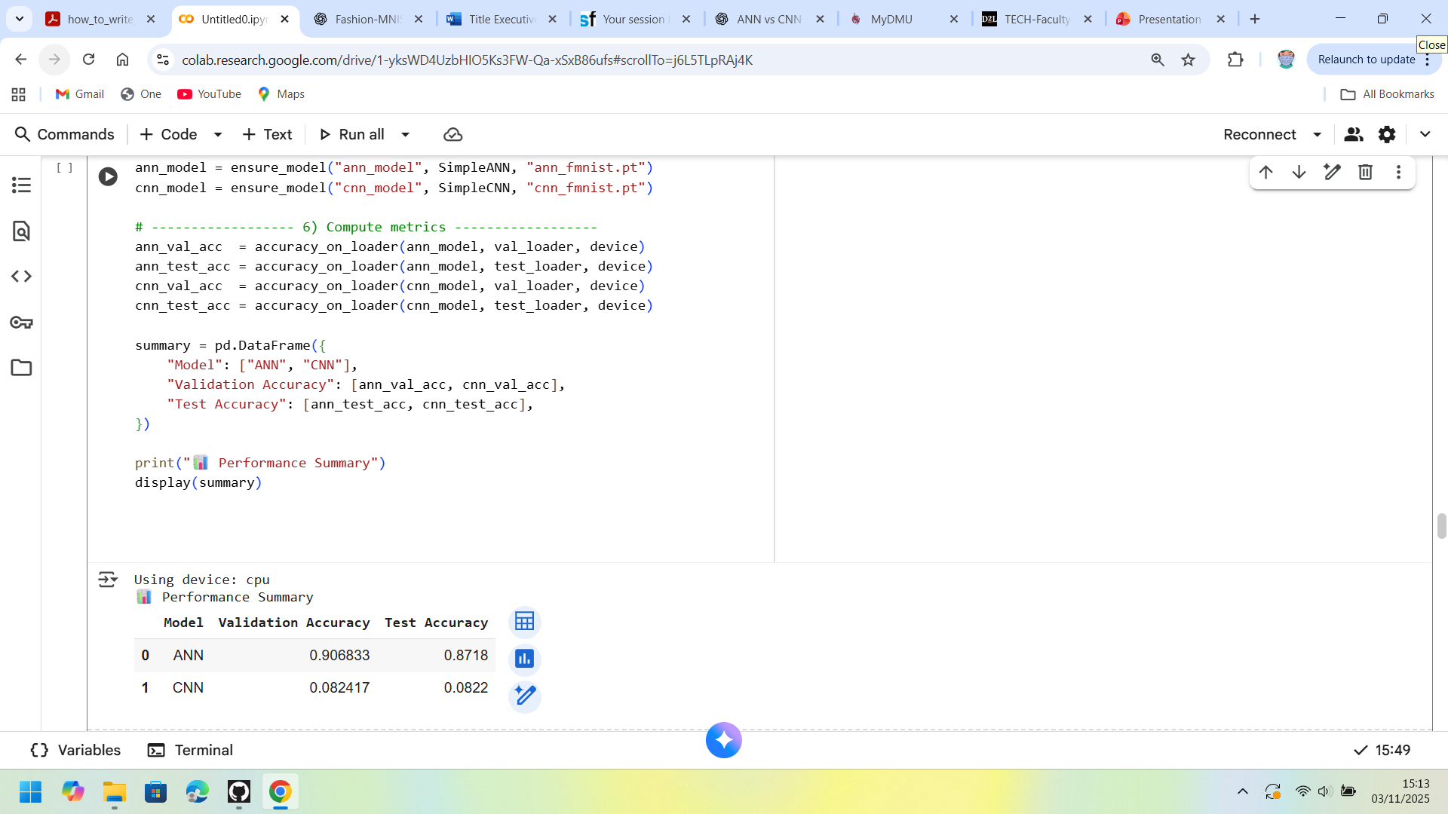
Results
loss & accuracy curves (two lines: train vs validation).
The corresponding , a table:

Slide 8
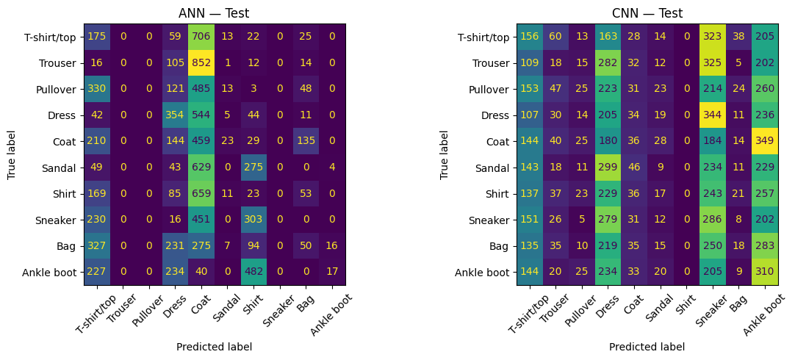
Confusion Matrices

Slide 9
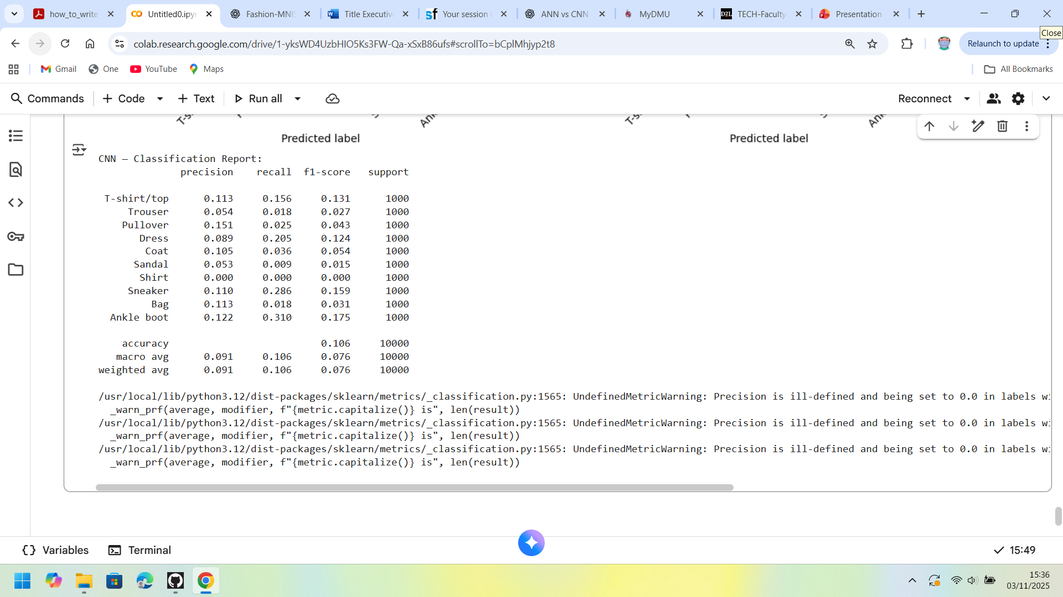
Analysis & Discussion
.Performance: CNN > ANN due to spatial feature learning.
Errors: Shirt ↔ Coat, Pullover ↔ T-shirt/top.
Improvements: augmentation (+2 %), dropout, LR scheduler.
Optional small image strip of 4–6 misclassified samples.

Slide 10
Conclusion & Future Work
CNN achieved ~90 % test accuracy
ANN baseline ≈ 85 %
Confirmed CNN’s advantage in vision tasks
Deeper networks (ResNet18)
Transfer learning experiments
More augmentation for robustness

